Slide 1
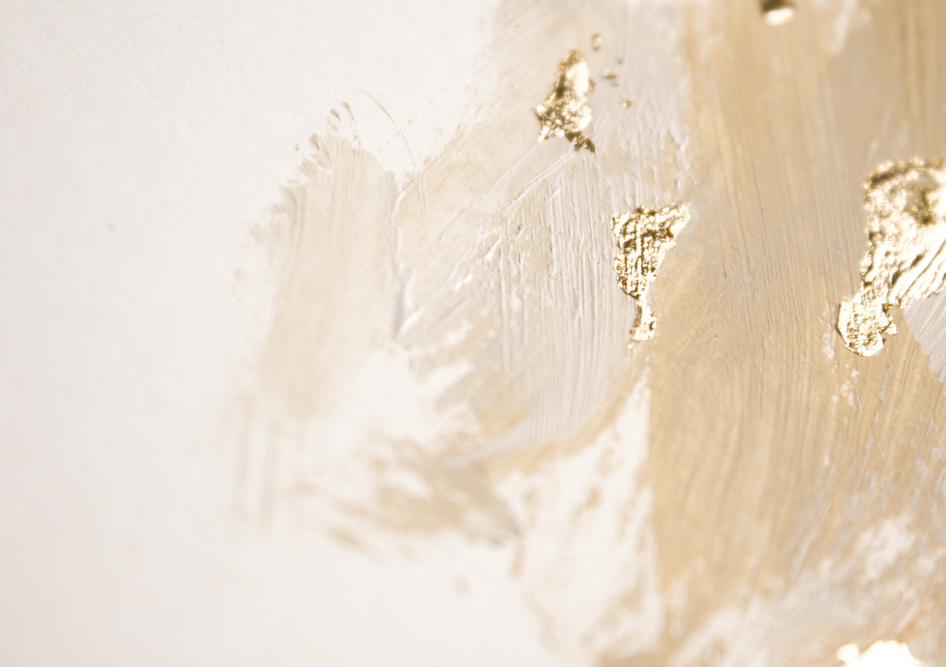











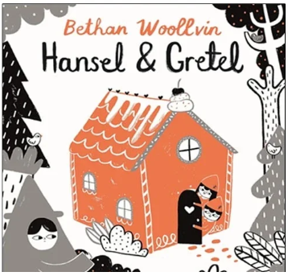
Year 2 Autumn Term 1
ENGLISH
KEY MESSAGES
In English this term, the children will read the ‘Missing Piece’ linked to this term’s theme of community.
We will be exploring traditional fairy tales this term with a focus on Hansel and Gretel, Little Red Riding Hood and Rapunzel. Children will recap the fundamentals of using a capital letter, full stop and finger spaces before moving on to looking at retelling a tradition tale with adjectives and simple time adverbials.
MATHS
In maths this term, children will visit place value (looking at ones and tens). When this is secure, children will move on to addition and subtraction.
Children will continue to build their number sense by following our daily mastering number programme.
Welcome to Year 2! We are very excited for the term ahead.
Our theme is ‘Community’, and we will enjoying lots of fun and engaging activities as we explore what a community is, the different people who are part of it and how we can contribute to our own community.
We will also be enjoying our traditional trip to New Road, which the children always look forward to!
Please encourage your child to read every day and continue using Numberblocks to practise and develop their maths skills.
If you have any questions or concerns, please don’t hesitate to speak to a member of the Year 2 team. We are always happy to help. We are looking forward to a fantastic term together!

Slide 2

Year 1 Autumn Term 1
GEOGRAPHY
In Geography, we will be the continents of the oceans of Earth. Children will explore where is hot and where is cold.
ART
PSHE & RE
This term the children will attend Art lessons with Mrs Bedford in the new Art room.
In RE we will begin learning about Islam.
In PSHE, children will explore the topic, ‘Living in our World’. This will link with this term’s theme of community.
SCIENCE
PE
Science this term is Animals. We will be identifying and classifying common animals.
PE
PE this term will be Monday and Tuesday.
Children will be doing athletics and fundamentals.
PHONICS
COMPUTING
Add here
Children will receive a phonics lesson a day. They are recapping with they have learnt form year 1 and some new sounds.
.
In computing this term children will explore how IT is used in school and outside of school.
MUSIC
Children will be exploring the glockenspiel this term.

