Slide 1


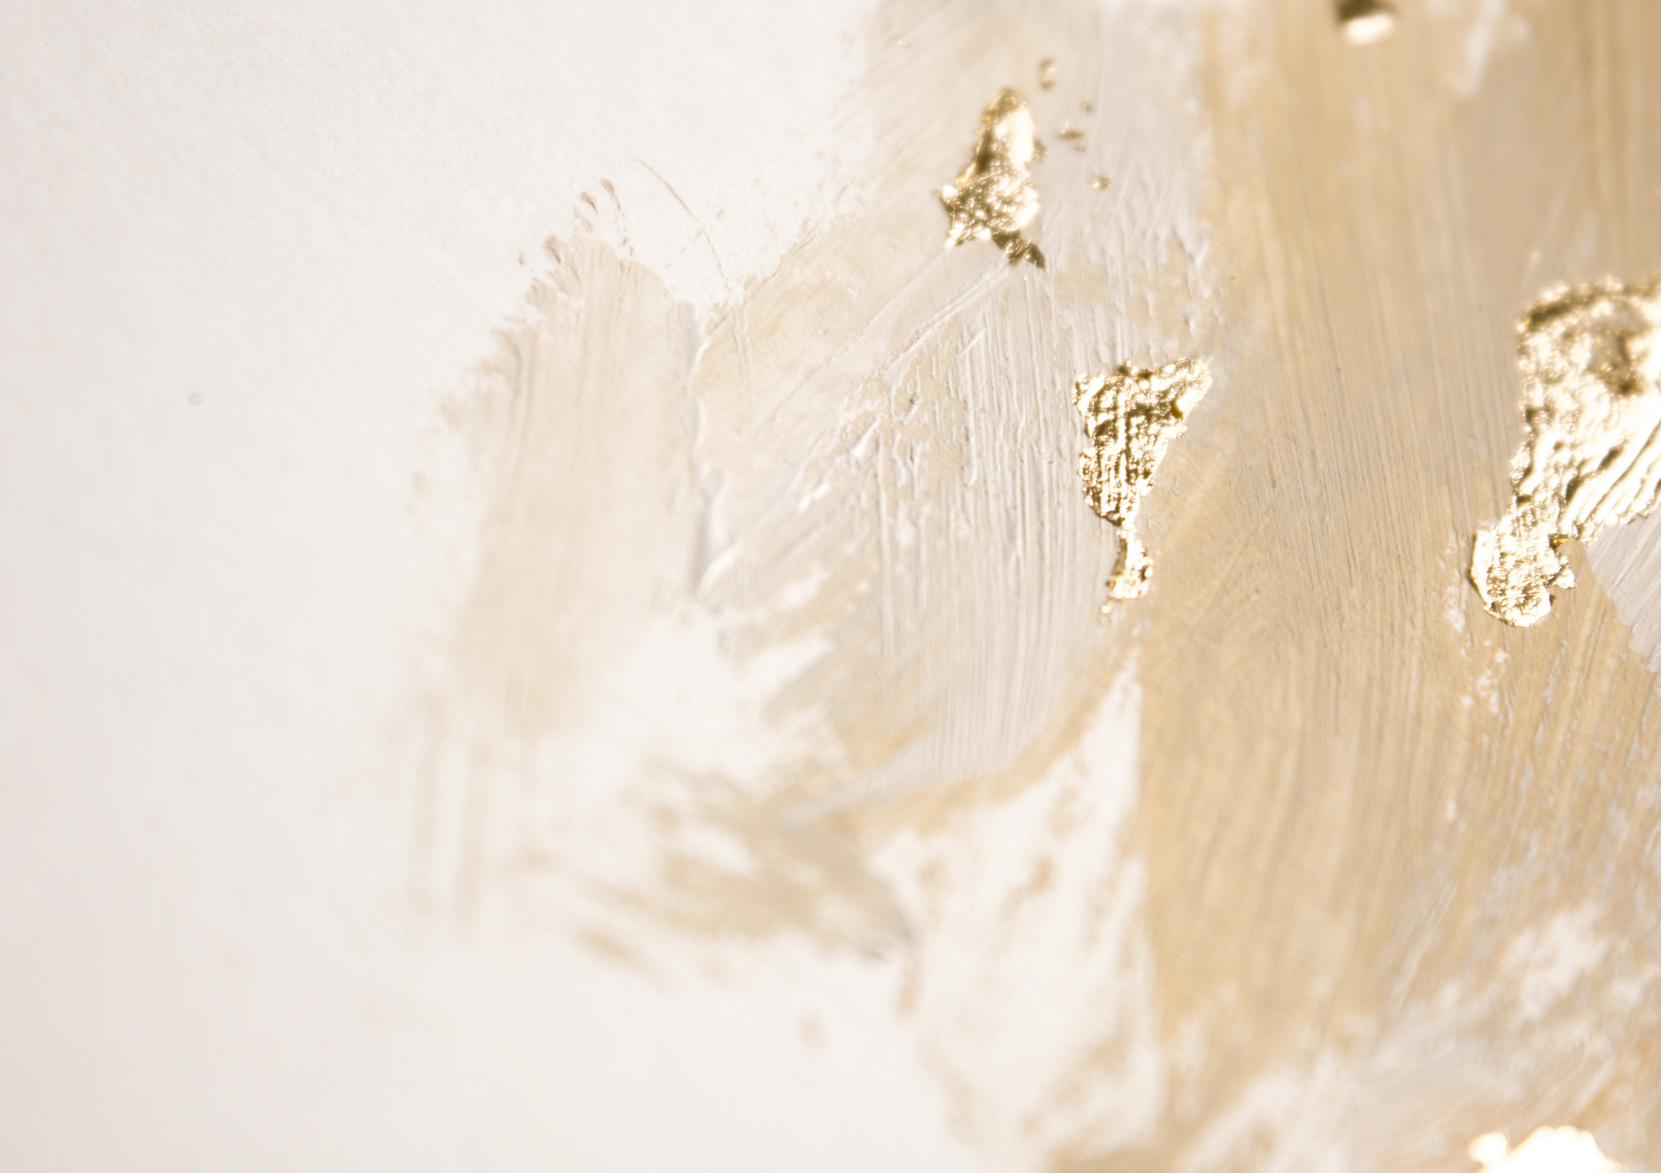



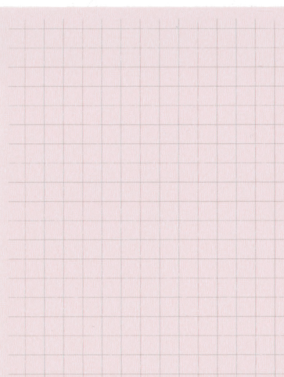



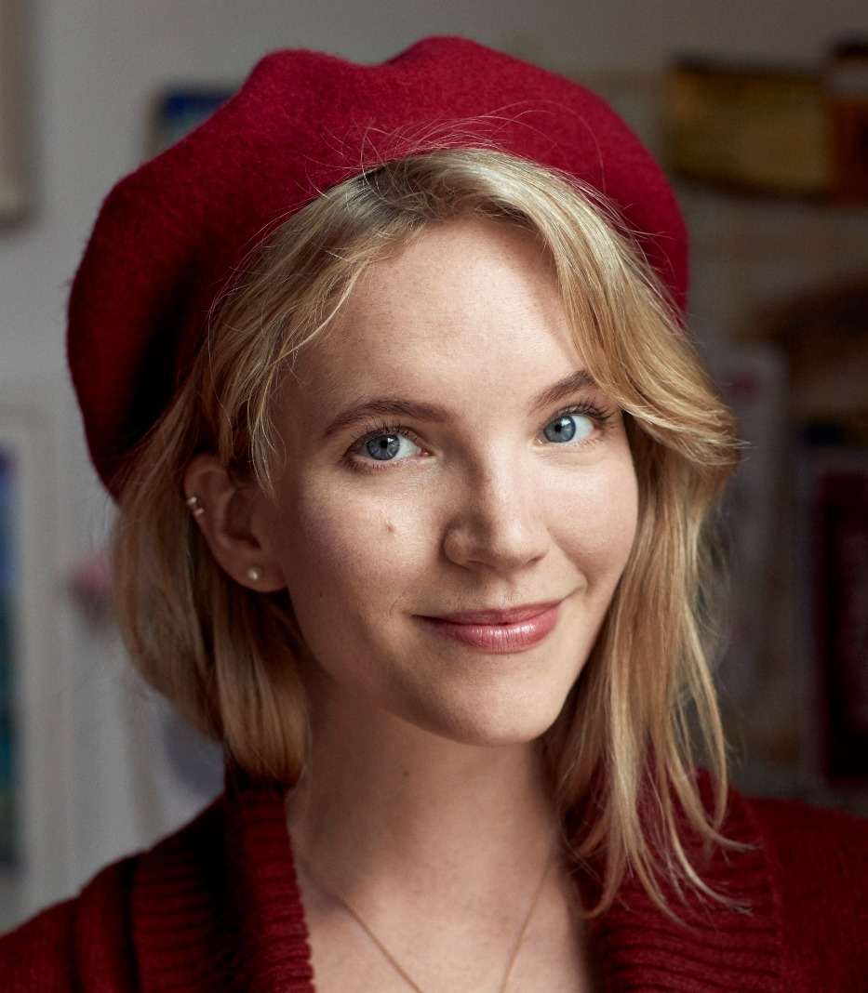
Year 5 Autumn Term 1
ENGLISH
KEY MESSAGES
This term we will be looking at The Hatmakers by Tamzin Merchant. It was a brand new book for the curriculum last year and we are so looking forward to the magical story.
We are encouraging children to join the local library to have access to a huge variety of books. A letter will be coming out soon to help families apply for them.
.
MATHS
Term 1 starts by looking at Place Value in Maths, followed by addition and subtraction skills. It is very important for children to feel confident in Maths and the most important place to start is with multiplication tables. Keep practicing them to stay fluent. We use them in so many areas of Maths.
Hello and welcome to Year 5. This year will be filled with lots of fun and learning.
In Term 1, the children have art and P.E. on a Thursday. Please make sure that your children come in appropriate clothing . Also, please remember to either remove piercings for PE days or be prepared to remove them for the session. Forest School will begin later in the term.
Please make sure children are fully equipped for each lesson by bringing a fully stocked pencil case (please see parent communications for the list), with spares available. They should also remember to restock when needed.
Term 1 texts

Slide 2

Year 5 Autumn Term 1
GEOGRAPHY / HISTORY
Geography will cover a range of skills including map work and will be looking at a range of contrasting locations.
ART/DT
PSHE & RE
In Art the children will be
Exploring land and city scapes using mixed media ..
In RE we will be thinking about why some people believe God exists. Our PSHE will also be spent looking at our local communities.
SCIENCE
PE
Science this term will be spent looking at
materials and their properties.
PE will be on a Wednesday and Thursday. The focus will be Fitness and Team building.
FRENCH
COMPUTING
Add here
In French we will be learning about some mixed up pets and how to describe them.
.
We will be starting the year with online safety skills we need for learning.
MUSIC
Children will be learning the Recorder this term.

