Slide 1
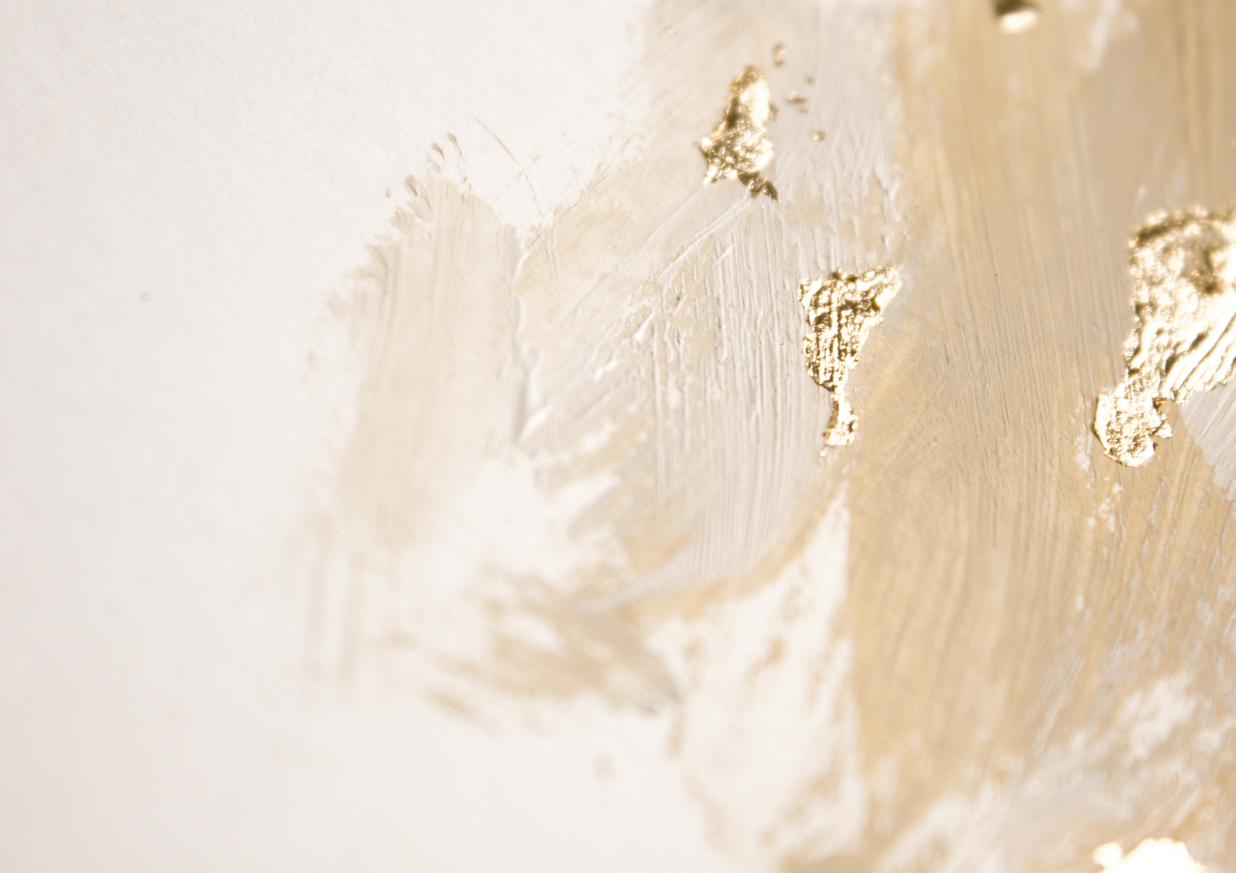





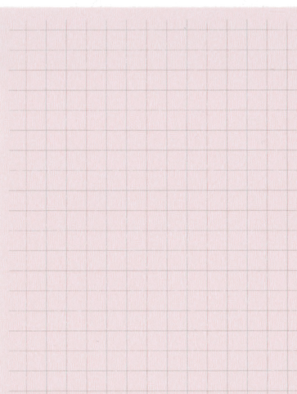



Year 6 Autumn Term 1
ENGLISH
KEY MESSAGES
This term we will be reading an exciting new text written by Malorie Blackman – Thief!
'Thief' is the story of Lydia Henson, who has recently moved to a new school and wants to join the group 'Cosmics' that her best friend Frankie is a member of. In order to test her courage and loyalty to the group, their leader – Anne – puts her on a mission which involves Lydia stealing the school sports cup.
We will be using this text to support the children with their creative writing. In particular we will explore writing a setting
description and an action story
that takes the reader through
time!
MATHS
The children will be consolidating number and place value. They will be taught to read, write, compare and order numbers to 10,000,000.
Children will be rounding numbers, including decimals. There will be a focus on the four operations and using number facts to solve problems.
Welcome to your children's final year at Palace Wood
Our Year 6 team is:
Juniper - Mrs Homewood & Mrs. Chidley
Corben - Mr Luka .
It is going to be an exciting year as we will be continuing to learn from our new curriculum that has been tailored to the children of Palace Wood.
Our first term is themed ‘Community’. We are excited to teaching it and hope you will enjoy the learning.
Term 1

Slide 2


Year 6 Autumn Term 1
P.E.
For this term, children will be developing their skills in outdoor adventure activity and fitness. Please ensure children are wearing suitable footwear for PE days.
DT
PSHE & RE
In DT this term, we will be looking at architecture over the past century with a focus on housing.
Children will be doing some hands learning, using equipment such as saws, glue-guns and trails.
In PHSE, our learning will be focused on stealing and water safety.
In RE we will explore the following question:
What difference does it make to believe in Ahimsa, Grace and/or Ummah?
SCIENCE
GEOGRAPHY
In Science this term we will be learning about light. Children will carry out several investigations seeking an answer to their hypothesis by observing the behaviour of light..
In Geography we will explore the human and physical features of Northern Ireland and Brazil and continue to develop our map skills. We will also compare cultures and lifestyles and hopefully get to taste some delicious food!
FRENCH
COMPUTING
Add here
In French this term, children will learn about the weather. They will develop their pronunciation of key vocabulary and develop their writing.
.
In Computing, the children will consolidate and deepen their understanding of internet safety and what it means to have an online persona and the lasting impact of posting online.
MUSIC
Instrument : Glockenspiels
Singing: Folk songs from different countries.

